Slide 1
Electric Vehicles Status Report for Washington State
177,866 | 21 | 330 Miles
Registered Electric Vehicles | Electric Utility Companies | Longest Range

Slide 2

Summary
Rapid Growth: 400% increase from 2017 in EV registrations, reaching 169, 504 EVs registrations by the end of 2023.
Popular Car Make: Tesla leads with 44.79% of the total EV population.
Electric Range: 50% of the vehicles have a range of 84 miles with a maximum of 330 miles and a minimum of 6miles.
Charging Infrastructure: There are a total of 21 electric utility companies. Puget Sound Energy Inc being the most popular.
Environmental Impact: Only 37.29% of the EVs are eligible as Clean Alternative Fuel Vehicles with 51.7 being categorized as unknown since the battery range has not been researched.

Slide 3

Tracking the growth and the current Number of EVs

Slide 4
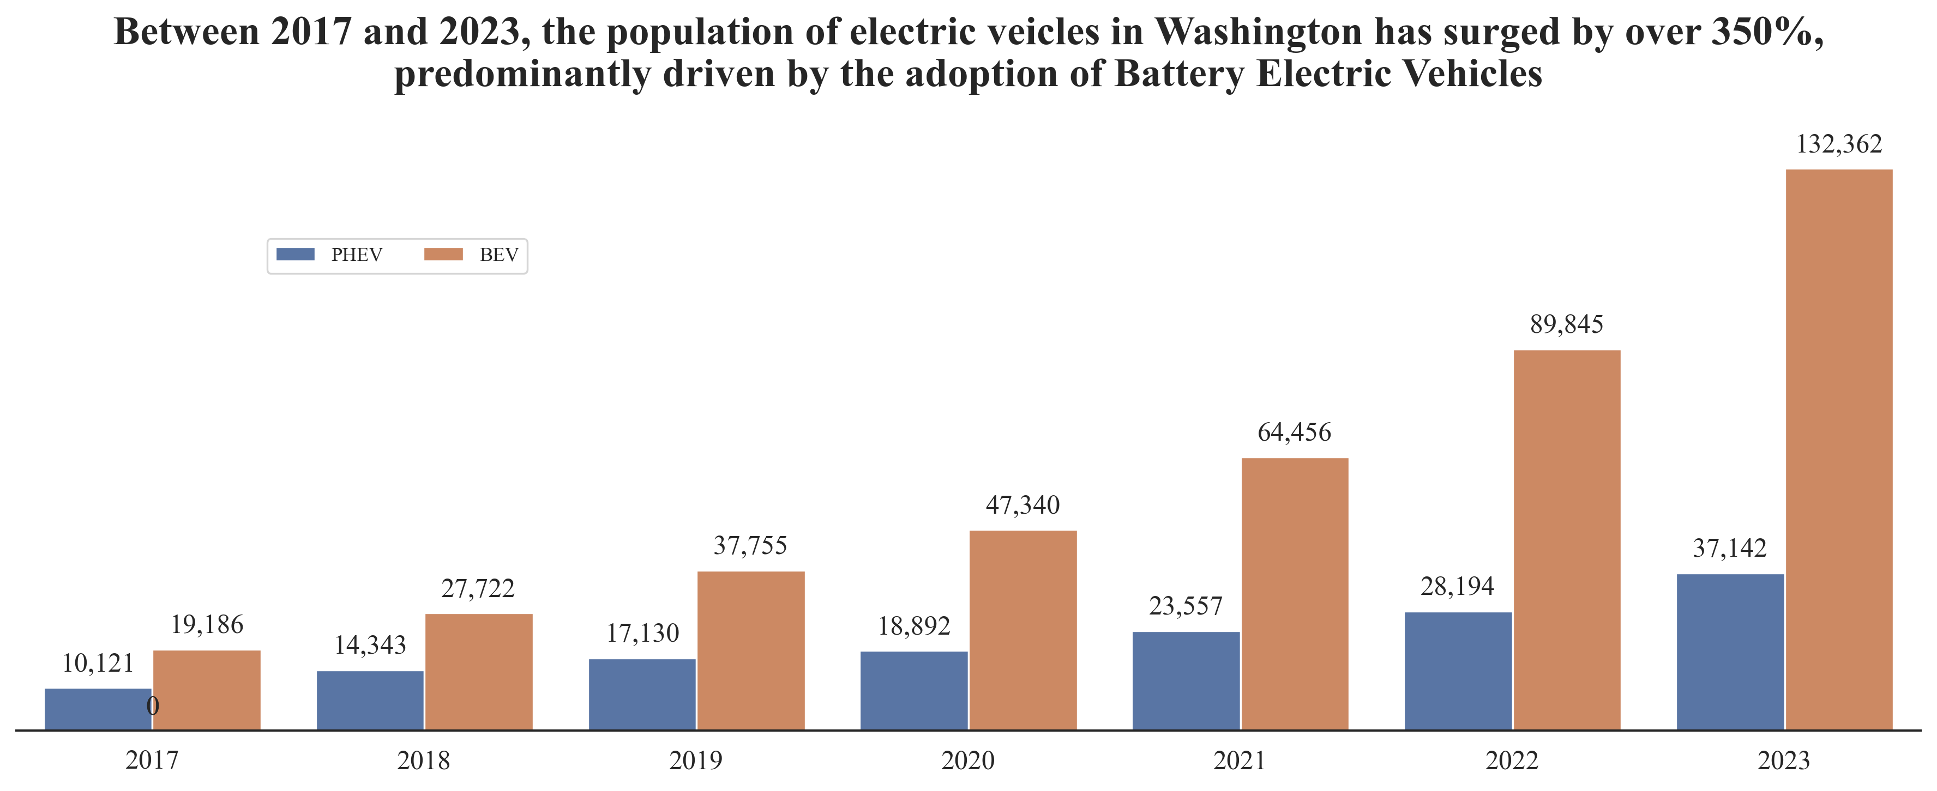
EV Growth trend

Slide 5
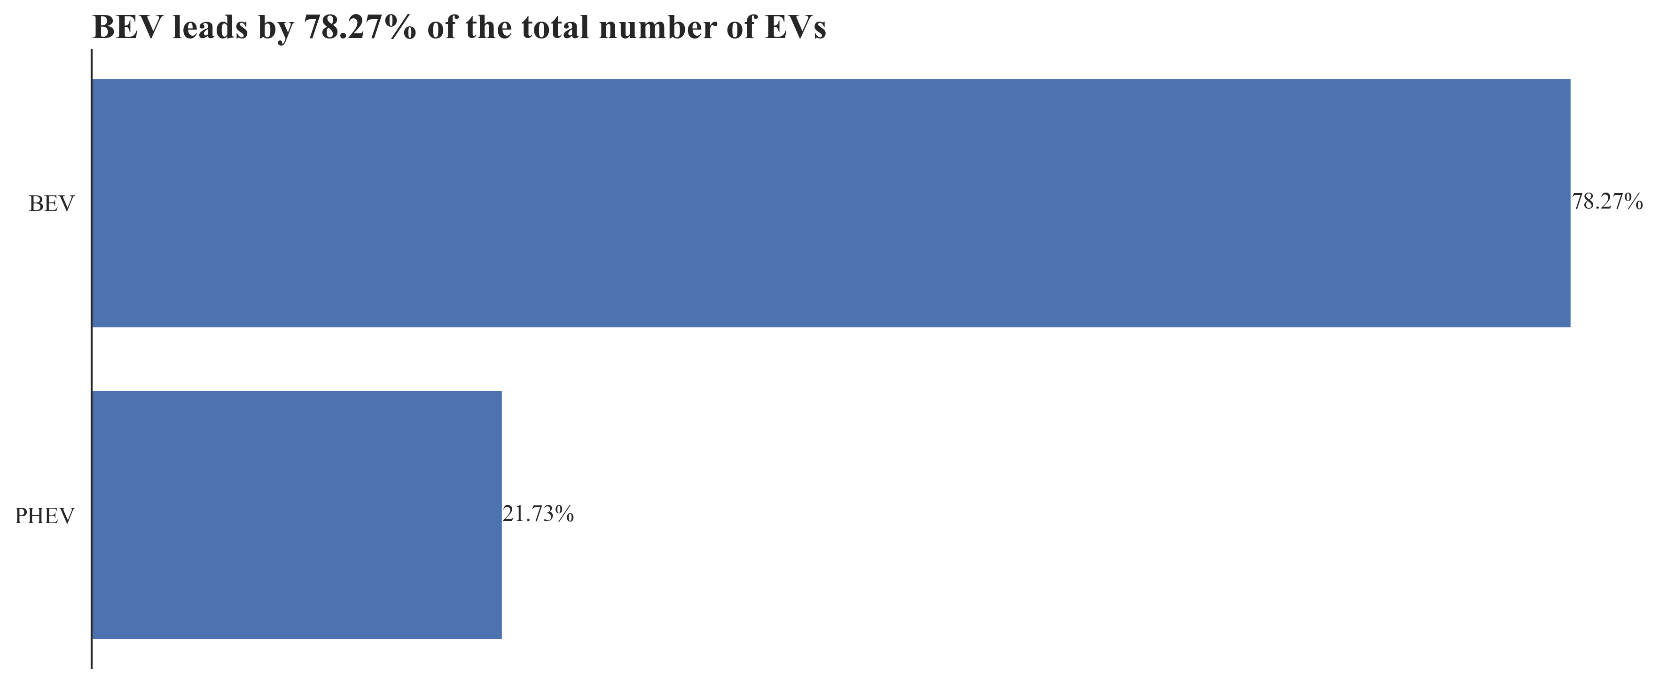
As of February 2024, total number of registered EVs reached 177,866.

Slide 6

Most Popular EV Make

Slide 7
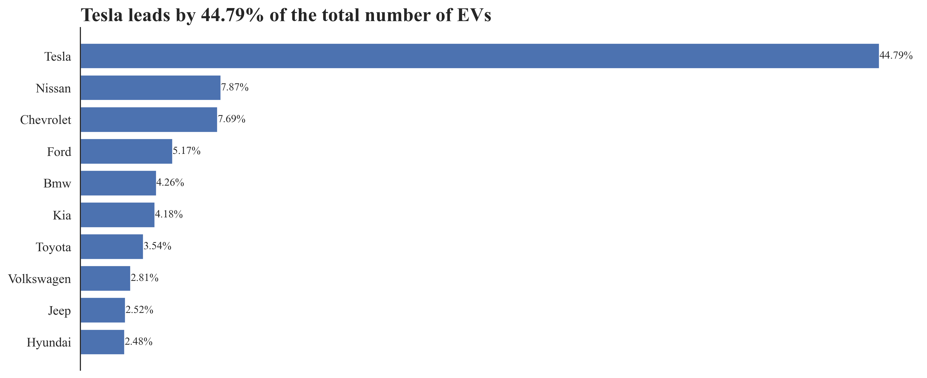
Top 10 EV makes

Slide 8
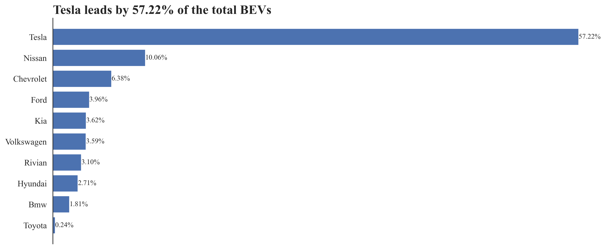
Top 10 BEV makes

Slide 9
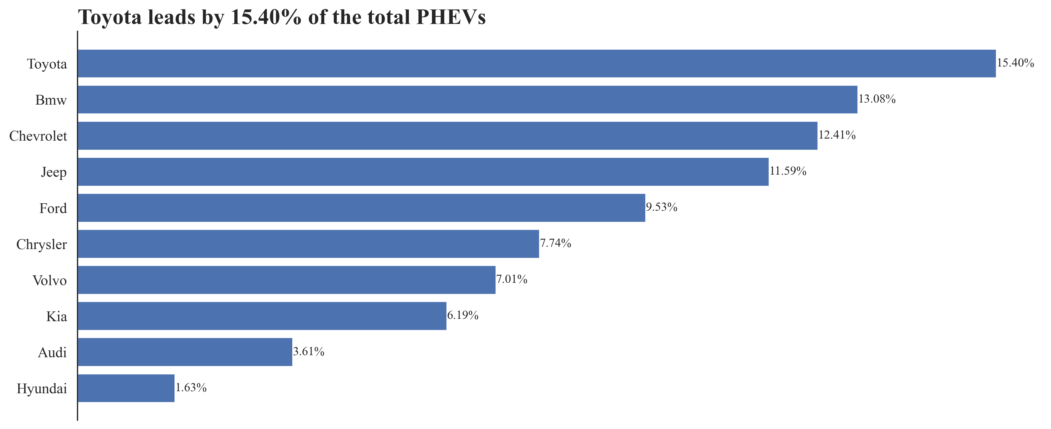
Top 10 PHEV makes

Slide 10
Electric Range of EVs

Slide 11
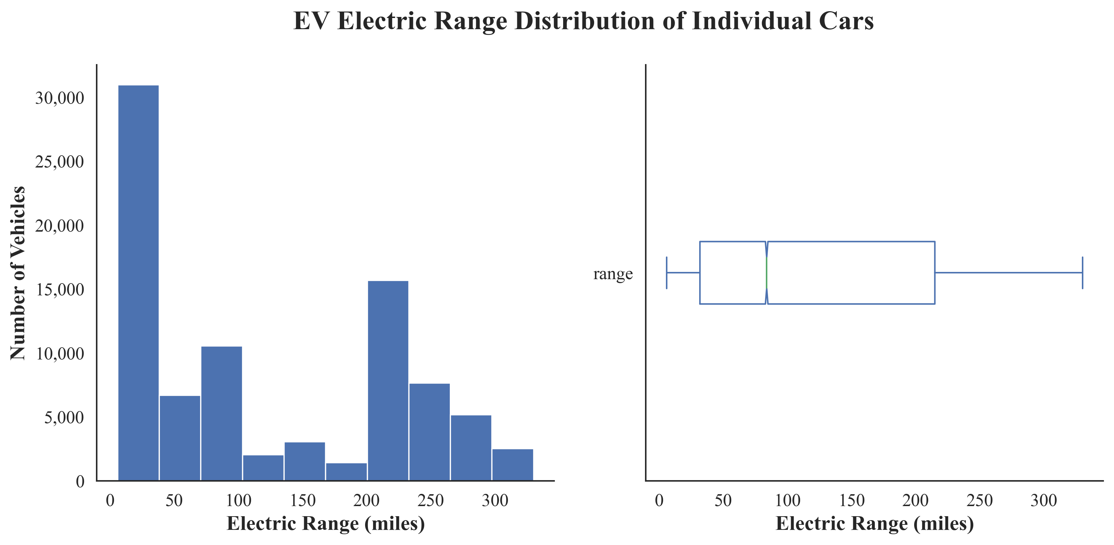
Mean: 121.63 miles
Median: 84 miles
Max: 330 miles
Min: 6 miles
The two peaks in the right skewed distribution indicates two groups of vehicles.
Long Range - >200miles
Short Range - <200 miles

Slide 12
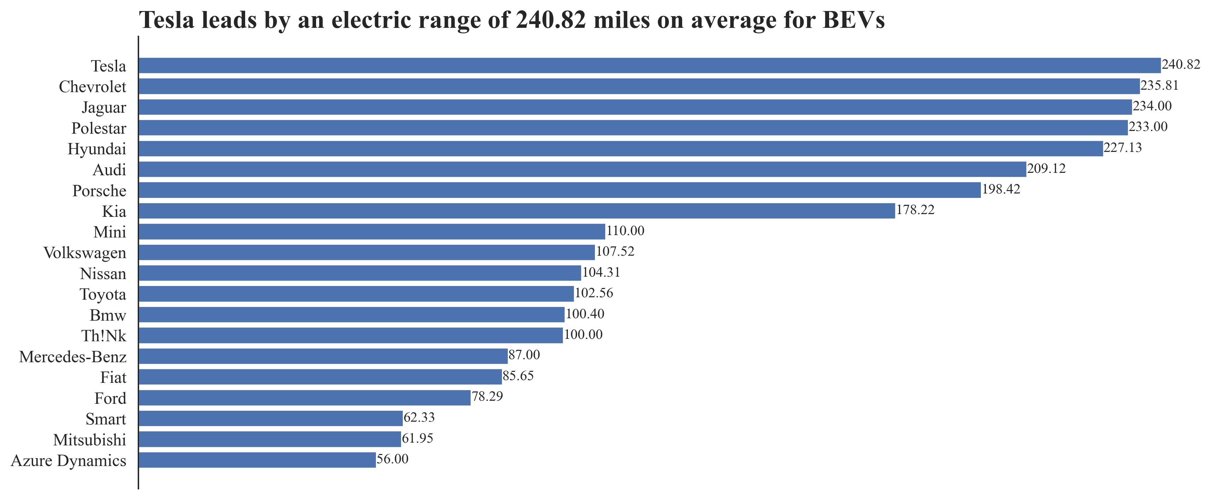
Average Electric Range per Make for BEV category

Slide 13
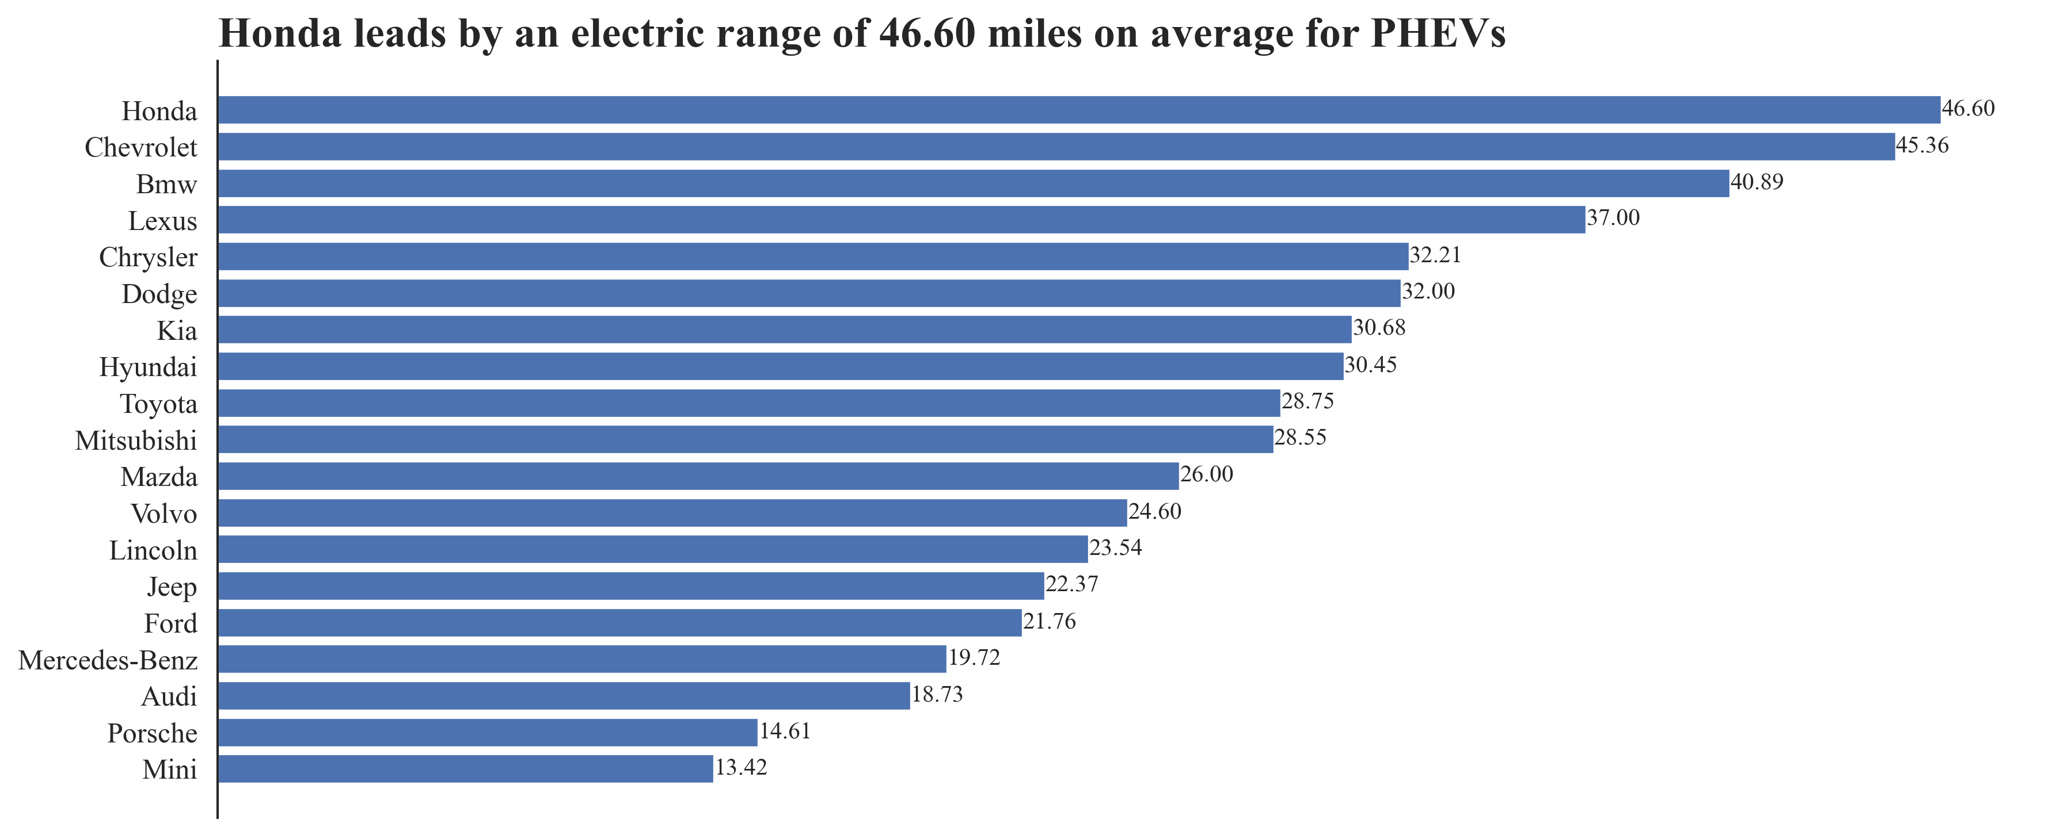
Average Electric Range per Make for PHEV category

Slide 14
Environmental Impact

Slide 15
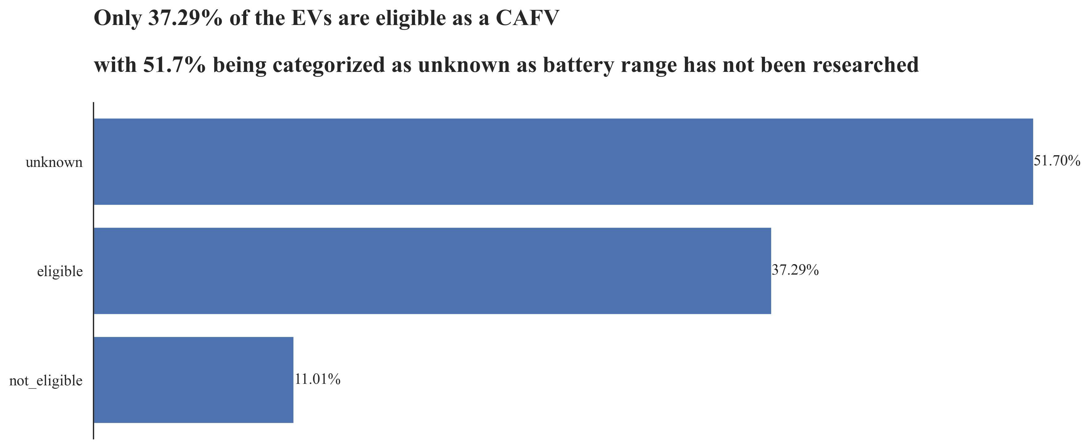
Clean Alternative Fuel Vehicle (CAFV) Eligibility

Slide 16
Recommendations

Slide 17

Maintain and adapt support for EVs to encourage long term sustainable growth as electric mobility matures this include expanding charging infrastructure especially where it is currently lacking.
PHEVs manufacturers should improve on the electric range of their battery.
Implement policies to reduce the number of combustion engines and fasten the research of the battery range to ensure a higher number of EVs being categorized as Clean Alternative Fuel Vehicle.

Slide 18
Data Analyst: Noah Oyugi Data Source: Electric Vehicle Population Data Data Tools: Pandas, NumPy, SciPy, SQL, Matplotlib, Seaborn

